Slide 1
COMP 2230
Week 13 - Wednesday

Slide 2
Last time
More on formal languages

Slide 3
Questions?

Slide 4
Assignment 6

Slide 5
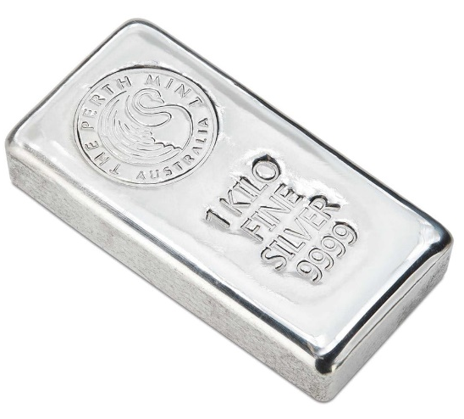
Logical warmup
A silver prospector didn't have the cash to pay his March rent in advance
But he owned a bar of pure silver, 31 inches long
He made the following arrangement with his landlady:
He would cut the bar into smaller pieces
On the first day of March he would give the lady an inch of the bar, and on each day, he would add another inch to her amount of silver
She would keep the silver as collateral
At the end of the month, when the prospector expected to be able to pay his rent in full, she would return the pieces to him
March has 31 days, so he could cut the bar into 31 one-inch sections
But since it was difficult to cut the bar, the prospector wished to carry out his agreement
with the fewest possible number of pieces
For example, he might give the lady an inch on the first day, another inch the second day, then on the third day he could take back the two pieces and give her a solid 3-inch section
What's the smallest number of pieces the prospector needs to cut his bar into so that his landlady can always have the amount needed for the given day?

Slide 6
Back to Formal Languages

Slide 7
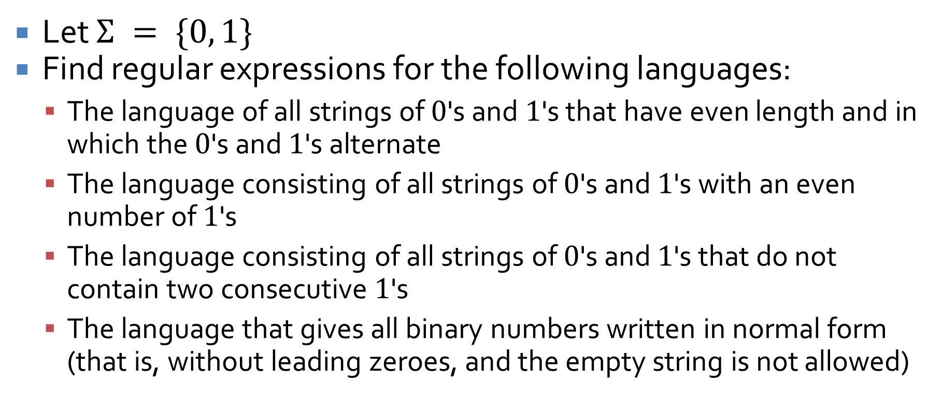
Examples
Let $Σ = \{0, 1\}$
Find regular expressions for the following languages:
The language of all strings of $0$'s and $1$'s that have even length and in which the $0$'s and $1$'s alternate
The language consisting of all strings of $0$'s and $1$'s with an even number of $1$'s
The language consisting of all strings of $0$'s and $1$'s that do not contain two consecutive $1$'s
The language that gives all binary numbers written in normal form (that is, without leading zeroes, and the empty string is not allowed)

Slide 8
Practical notation
Regular expressions are used in some programming languages (notably Perl and Javascript) and in grep and other find and replace tools
The notation is generally extended to make it a little easier, as in the following:
[A–C] means any character in that range,
[A–C] means (A|B|C)
[0–9] means (0|1|2|3|4|5|6|7|8|9)
[ABC] means (A|B|C)
ABC means the concatenation of A, B, and C
A dot stands for any character: A.C could match AxC, A&C, ABC
^ means NOT, thus [^D–Z] means not the characters D through Z
Repetitions:
R? means 0 or 1 repetitions of R
R* means 0 or more repetitions of R
R+ means 1 or more repetitions of R
Notations vary and have considerable complexity
Use this notation to describe the regular expression for legal Java identifiers

Slide 9
Finite-State Automata
Three-Sentence Summary

Slide 10
Finite-State Automata

Slide 11
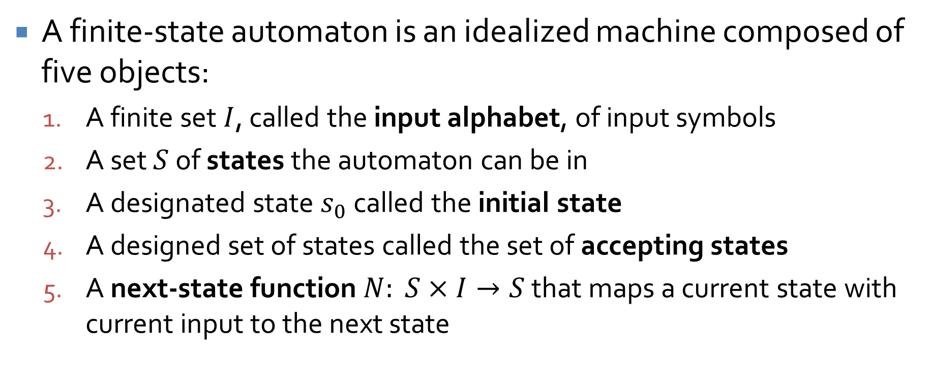
Finite-state automaton
A finite-state automaton is an idealized machine composed of five objects:
A finite set $I$, called the input alphabet, of input symbols
A set $S$ of states the automaton can be in
A designated state $s_{0}$ called the initial state
A designed set of states called the set of accepting states
A next-state function $N: S×I→S$ that maps a current state with current input to the next state

Slide 12
Transition diagram
FSA's are often described with a state transition diagram
The starting state has an arrow
The accepting states are marked with circles
Each rule is represented by a labeled transition arrow
The following FSA represents a vending machine
quarter
25¢
half-dollar
75¢
quarter
half-dollar
$1.25
0¢
quarter
half-dollar
quarter
quarter
quarter
50¢
$1
half-dollar
half-dollar
half-dollar

Slide 13



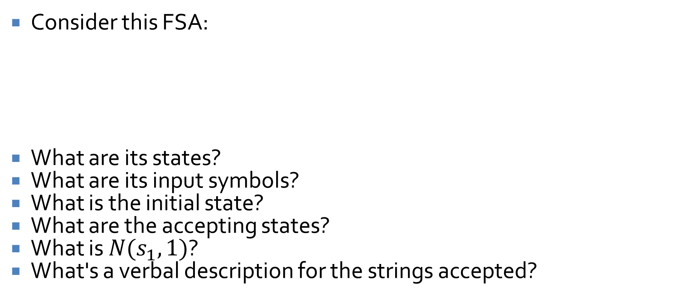





FSA example
$$1$$
Consider this FSA:
What are its states?
What are its input symbols?
What is the initial state?
What are the accepting states?
What is $N(s_{1}, 1)$?
What's a verbal description for the strings accepted?
$$s_{0}$$
$$s_{1}$$
$$1$$
$$s_{2}$$
$$0$$
$$0$$
$$1$$
$$0$$

Slide 14
Annotated next-state tables
$$1$$
Consider the same FSA:
We can also describe an FSA using an annotated next-state table
A next-state table gives shows what the transition is for each state for all possible input
An annotated next-state table also marks the initial state and accepting states
Find the annotated next-state table for this FSA
$$s_{0}$$
$$s_{1}$$
$$1$$
$$s_{2}$$
$$0$$
$$0$$
$$1$$
$$0$$

Slide 15
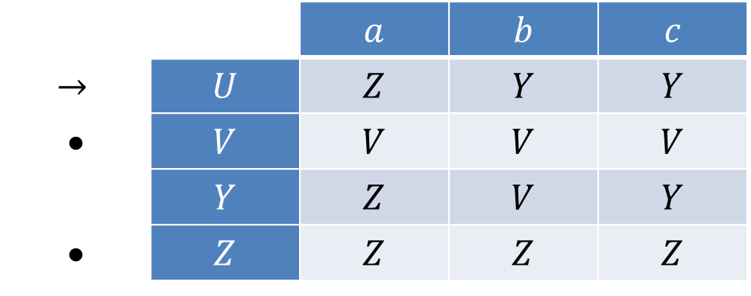

Table to transition diagram
Consider the following annotated next-state table
$→$ marks initial state
• marks accepting states:
Draw the corresponding transition state diagram
 |  | $$a$$ | $$b$$ | $$c$$
$$→$$ | $$U$$ | $$Z$$ | $$Y$$ | $$Y$$
• | $$V$$ | $$V$$ | $$V$$ | $$V$$
 | $$Y$$ | $$Z$$ | $$V$$ | $$Y$$
• | $$Z$$ | $$Z$$ | $$Z$$ | $$Z$$

Slide 16
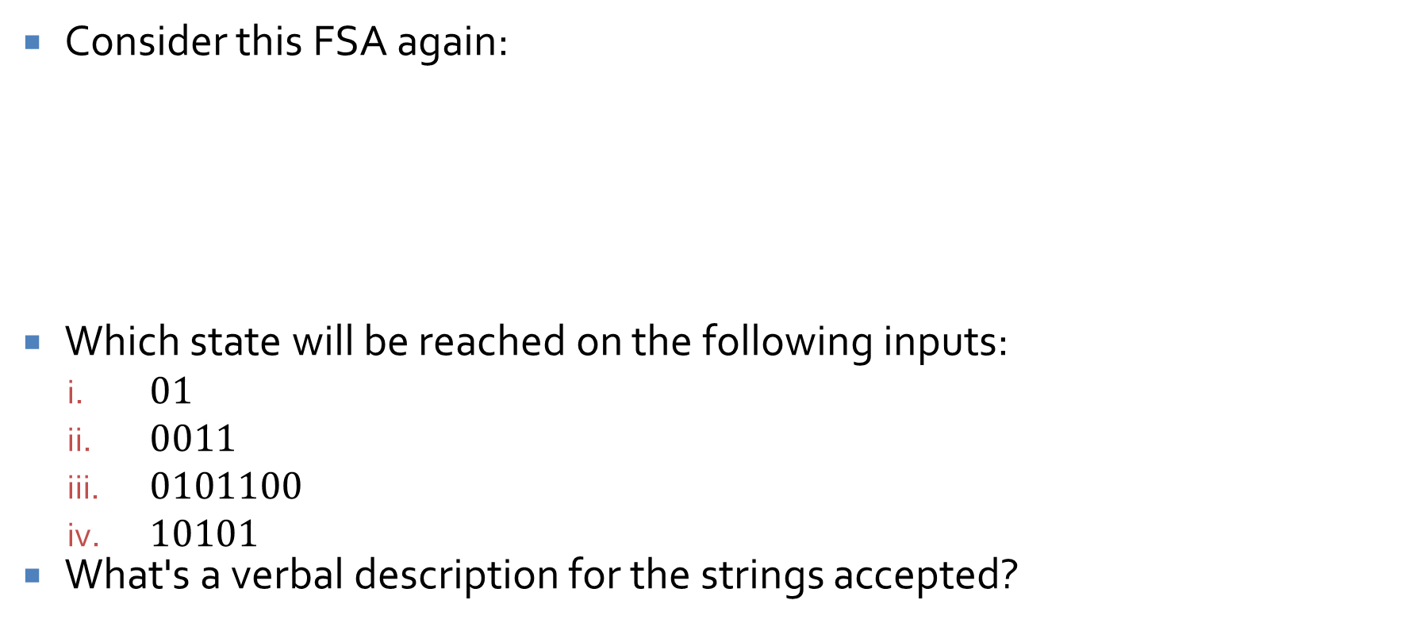
FSA example
$$1$$
Consider this FSA again:
Which state will be reached on the following inputs:
$01$
$0011$
$0101100$
$10101$
What's a verbal description for the strings accepted?
$$s_{0}$$
$$s_{1}$$
$$1$$
$$s_{2}$$
$$0$$
$$0$$
$$1$$
$$0$$

Slide 17
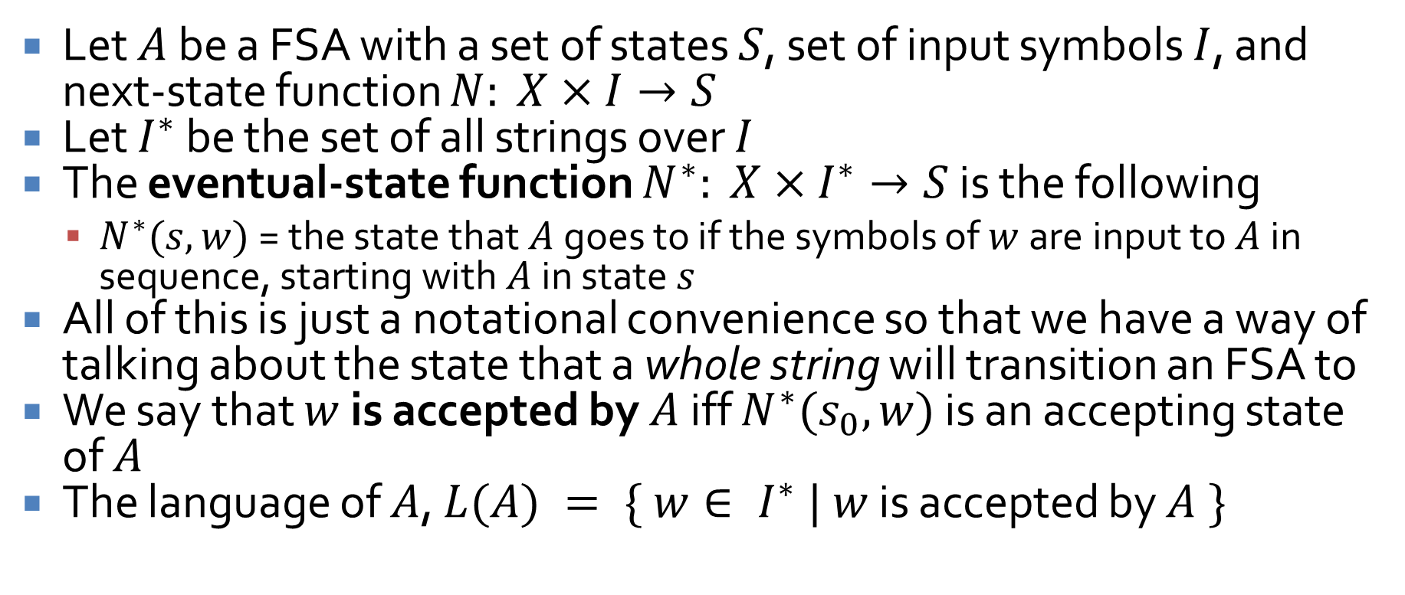
Eventual-state function
Let $A$ be a FSA with a set of states $S$, set of input symbols $I$, and next-state function $N: X×I→S$
Let $I^{∗}$ be the set of all strings over $I$
The eventual-state function $N^{∗}: X×I^{∗}→S$ is the following
$N^{∗}(s,w)$ = the state that $A$ goes to if the symbols of $w$ are input to $A$ in sequence, starting with $A$ in state $s$
All of this is just a notational convenience so that we have a way of talking about the state that a whole string will transition an FSA to
We say that $w$ is accepted by $A$ iff $N^{∗}(s_{0}, w)$ is an accepting state of $A$
The language of $A$, $L(A) = \{ w∈ I^{∗} | w$ is accepted by $A \}$

Slide 18
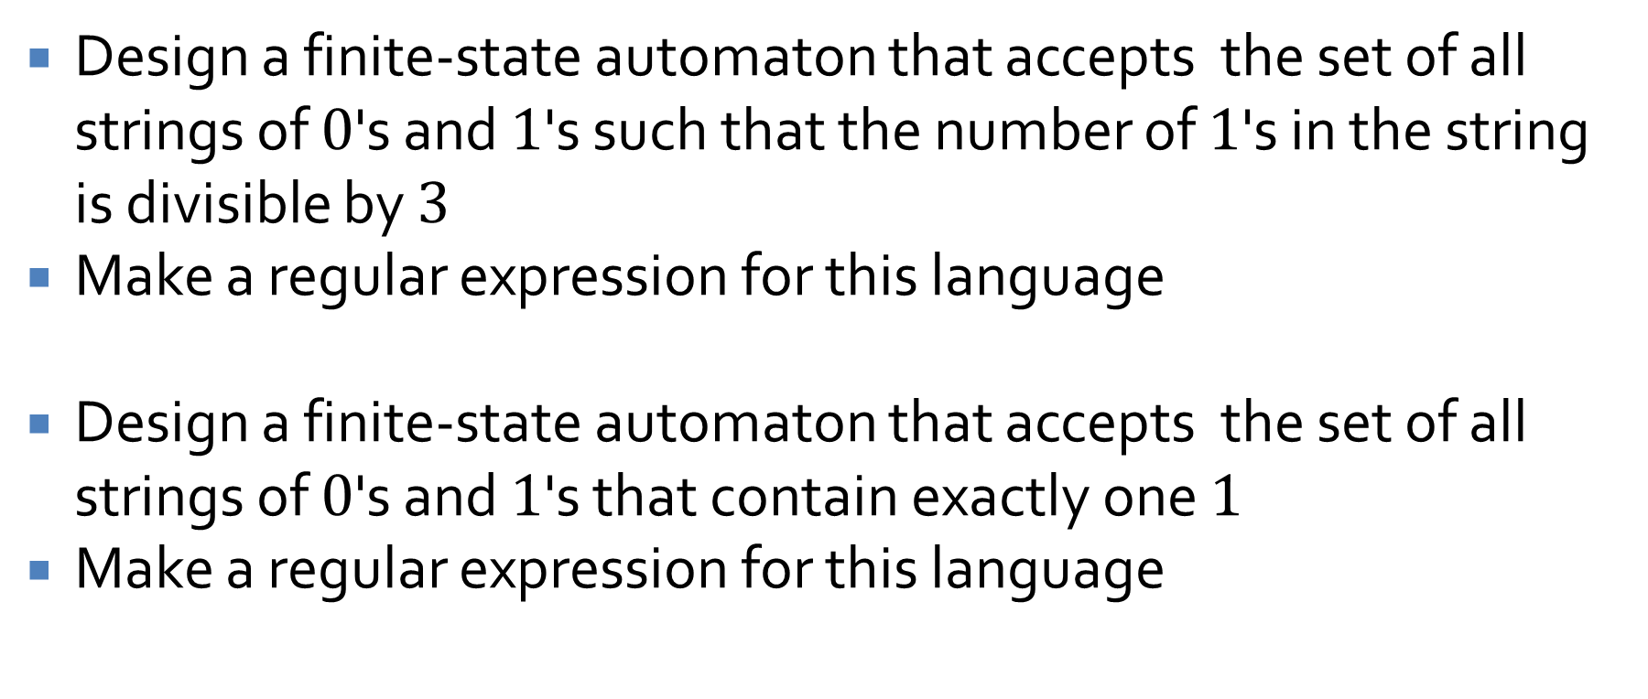
Designing automata
Design a finite-state automaton that accepts the set of all strings of $0$'s and $1$'s such that the number of $1$'s in the string is divisible by $3$
Make a regular expression for this language
Design a finite-state automaton that accepts the set of all strings of $0$'s and $1$'s that contain exactly one $1$
Make a regular expression for this language

Slide 19
Upcoming

Slide 20
Next time…
Simplifying finite state automata

Slide 21
Reminders
Keep working on Assignment 6
Read 12.3 for Friday
Prepare a three-sentence summary
Extra credit if you get called on

